Slide 1
UML + Class Diagram

Slide 2
What is UML?
The Unified Modelling Language is a standard graphical language for modelling object oriented software
UML stands for Unified Modeling Language.
UML is different from the other common programming languages such as C++, Java, COBOL, etc.
UML is a pictorial language used to make software blueprints.
UML can be described as a general purpose visual modeling language to visualize, construct and document software system.

Slide 3
Types of UML diagrams
Class diagram
describe classes and their relationships
Interaction diagrams /Sequence diagram
show the behaviour of systems in terms of how objects interact with each other
Activity diagrams
show how systems behave internally
Component and deployment diagrams
show how the various components of systems are arranged logically and physically

Slide 4
01. Class Diagram

Slide 5
Class
Class is an entity which have
Data
Behavior
Example Student
Data : roll no, Name, Mobile No, GPA
Behavior: add course, drop course, withdraw course
All objects that exhibit same data and behavior can be formed into a class.
Class are usually nouns in requirement document.
In much simpler words: Actors of the Use Case Diagram can be converted into classes in a Class Diagram.

Slide 6
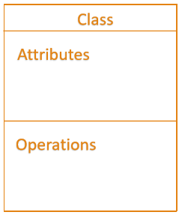
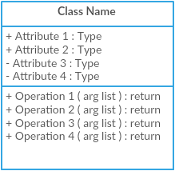
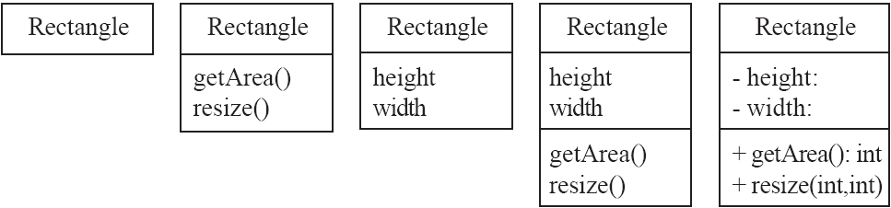
Main components of class Diagram
Class (Actors/Users)
Attributes (Variables)
Operations (Functions)

Slide 7
Components of Class Diagrams
Classes: Represented by rectangles, a class defines the properties (attributes) and behaviors (methods) that objects created from the class will have.
Example: A "Customer" class with attributes like "name" and "email", and methods like "placeOrder()".
Attributes: Characteristics or properties of a class.
Example: For a "Book" class, attributes could be "title", "author", "ISBN".
Methods: Functions or operations that a class can perform.
Example: For a "Book" class, methods could be "borrow()", "return()".

Slide 8
Attributes and operations
An attribute is a named property of a class that describes the object being modeled.
In the class diagram, attributes appear in the second compartment just below the name compartment.
Operations or methods are the functions of the class
Operations describe the class behavior and appear in the third compartment.

Slide 9
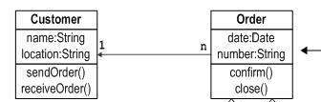
What is Class Diagram
A class diagram is a UML diagram type that describes a system by visualizing the different types of classes within a system and the kinds of static relationships that exist among them.
It illustrates
the operations and attributes of the classes.
Relationship between the classes

Slide 10
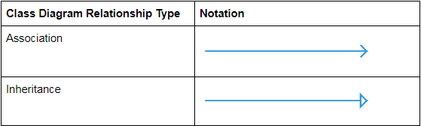
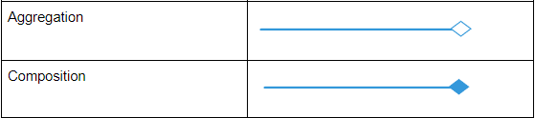
Class Diagram Relationships

Slide 11
Relationships in a Class Diagram
Associations: Represented by lines connecting classes, indicating a relationship between them.
Example: A "Customer" is associated with "Order".
Inheritance (Generalization): Represented by a line with a closed arrowhead pointing to the parent class, indicating that one class inherits from another.
Example: A "SavingsAccount" inherits from "Account".
Aggregation: Represented by a line with a diamond at the parent class end, indicating a whole-part relationship.
Example: A "Library" has "Books".
Composition: A stronger form of aggregation, indicated by a filled diamond.
Example: A "House" has "Rooms".

Slide 12
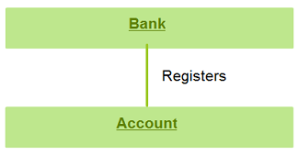
1. Associations
An association relation is established when two classes are connected to each other in any way.
For example:
A bank registers account.
An association is used to show how two classes are related to each other

Slide 13
Multiplicity/Cardinality
Multiplicity: Indicates how many instances of a class are associated with another class.
The cardinality/multiplicity of each relationship is shown with a number or letter on the lines that connect entities and relationships like
One-to-many (1:M), Many-to-many (M:N or M:M), One-to-one (1:1)
OR
One-to-many (1…*), Many-to-many (*…*), One-to-one (1…1)
If you know that a more precise cardinality exists, you can show the specific number or range

Slide 14
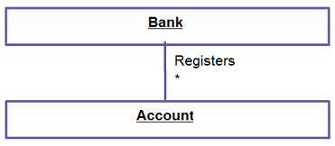
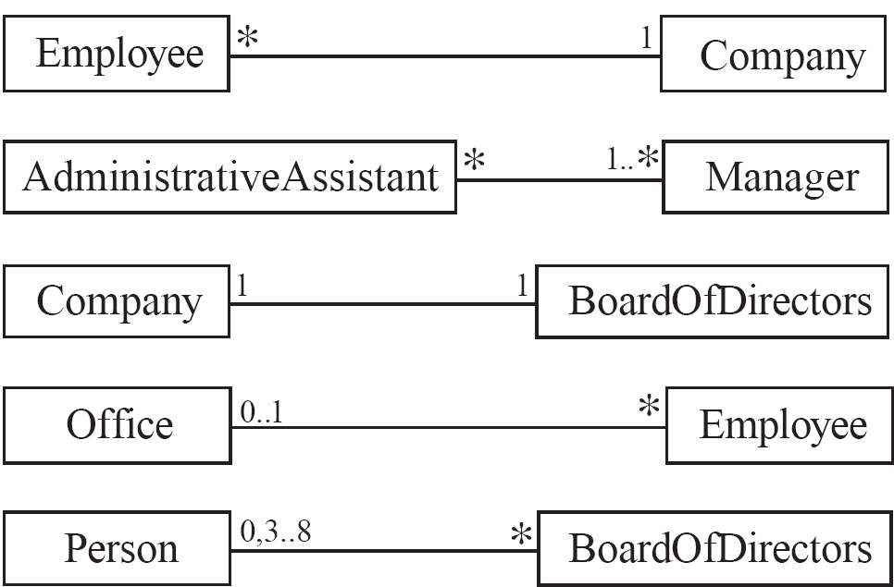
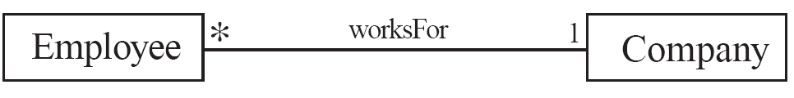
Multiplicity/Cardinality
An example of this kind of association is many accounts being registered by the bank. Hence, the relationship shows a star sign near the account class (one to many and many to many etc).
Symbols indicating multiplicity are shown at each end of the association
Each association can be labelled, to make explicit the nature of the association

Slide 15
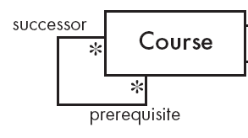
Reflexive Associations
It is possible for an association to connect a class to itself

Slide 16
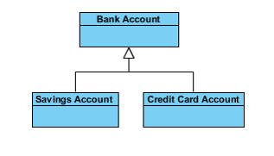
2. Generalization
Generalization is known as an “is a” relationship
the child class is a type of the parent class
Generalization is the ideal type of relationship that is used to showcase reusable elements in the class diagram.
The child classes “inherit” the common functionality defined in the parent class.

Slide 17
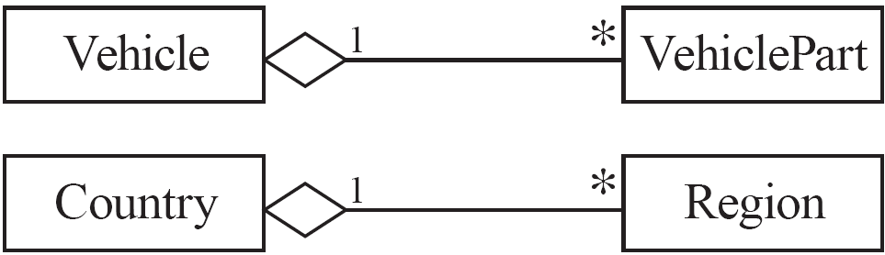

3. Aggregation
It is also called a “has a” relationship.
Aggregations are special associations that represent ‘part-of’ relationships.
While if A and B are associated with each other, such that B can exist without being associated with A, then this association in known as Aggregation.

Slide 18
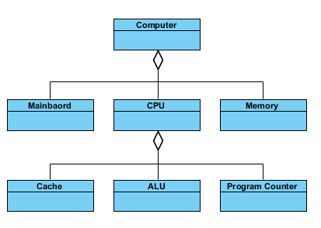

Slide 19
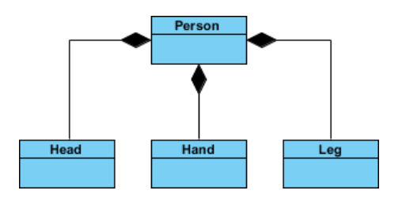

4. Composition
The composition is a variation of the aggregation relationship.
A composition is a strong kind of aggregation
if the aggregate is destroyed, then the parts are destroyed as well
If A and B two classes are related to each other such that, B ceased to exist, when A is destroyed, then the association between two objects is known as Composition. An example is Building and room.

Slide 20
How to draw class diagram
Step 1: Identify the class names
Step 2: Identify the attributes and operations of the class
Step 3: Distinguish relationships
Next step is to determine how each of the classes or objects are related to one another.
Step 4: Create the Structure
First, add the class names and link them with the appropriate connectors. You can add attributes and functions/ methods/ operations later.

Slide 21
Points to Remember
The name of the class diagram should be meaningful to describe the aspect of the system.
Each element and their relationships should be identified in advance.
Responsibility (attributes and methods) of each class should be clearly identified
Use notes whenever required to describe some aspect of the diagram.
At the end of the drawing it should be understandable to the developer/coder.
Finally, before making the final version, the diagram should be drawn on plain paper and reworked as many times as possible to make it correct.
Notes:
https://www.visual-paradigm.com/guide/uml-unified-modeling-language/what-is-class-diagram/

Slide 22
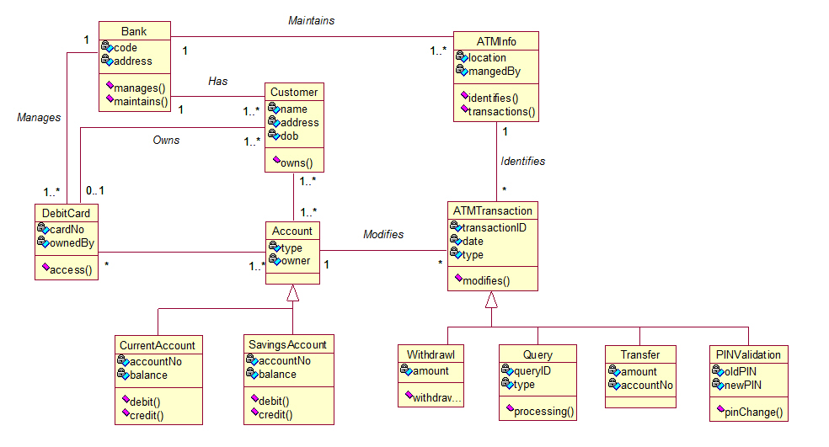

Slide 23
